Slide 1
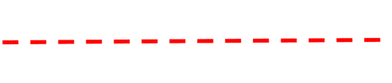
Let’s talk circles…
Skill 6: Shapes
How many of these red lines would it take to make the blue circle?

Slide 2


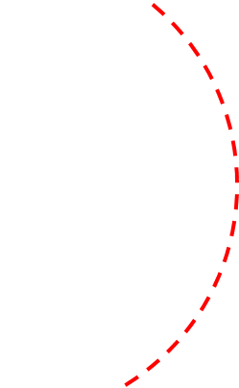
Let’s talk circles…
Skill 6: Shapes
How many of these red lines would it take to make the blue circle?

Slide 3



Let’s talk circles…
Skill 6: Shapes
How many of these red lines would it take to make the blue circle?

Slide 4




Let’s talk circles…
Skill 6: Shapes
How many of these red lines would it take to make the blue circle?

Slide 5
Let’s talk circles…
Skill 6: Shapes
How many of these red squares would fit into the blue circle?

Slide 6

Let’s talk circles…
Skill 6: Shapes
How many of these red squares would fit into the blue circle?

Slide 7

Let’s talk circles…
Skill 6: Shapes
How many of these red squares would fit into the blue circle?

Slide 8

Let’s talk circles…
Skill 6: Shapes
How many of these red squares would fit into the blue circle?

