Slide 1

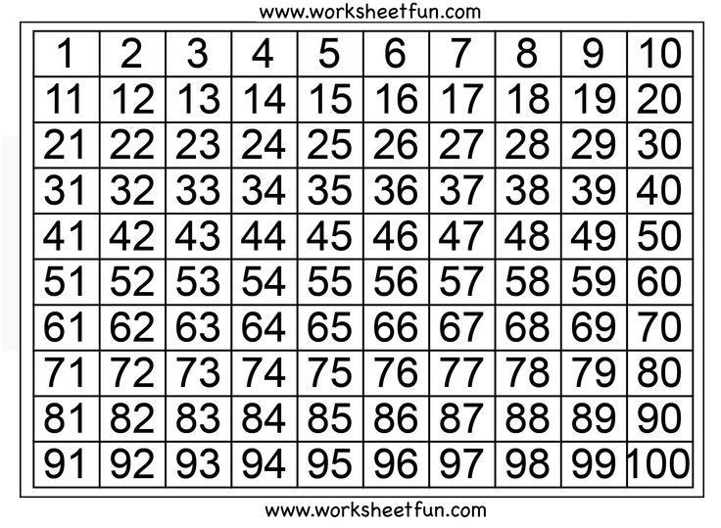

Slide 2

the
the

