Slide 1
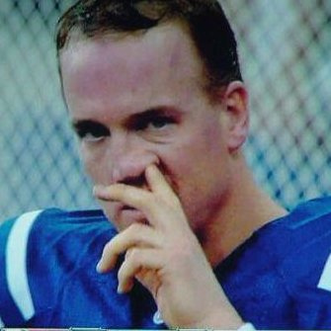
Pick ‘em

Slide 2
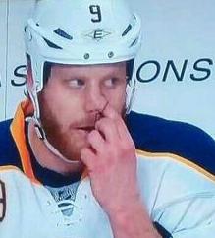
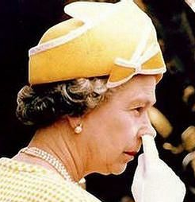
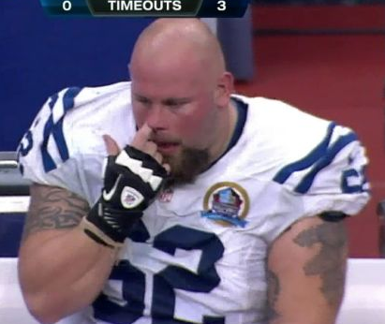
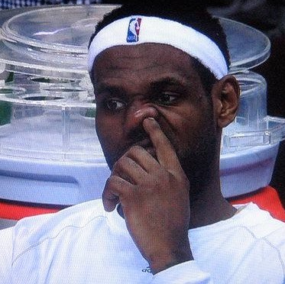
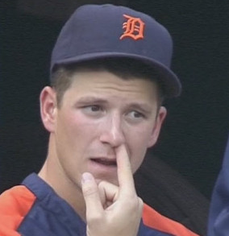


Don’t Erase!

Slide 3

Pick ‘n’ Role

Slide 4


Use Four
Key Vocab
Radical
Reduce
Square Root
Factors
Imaginary
Exponent
Variable

Slide 5

Pass ‘em

