Slide 1
Templates
Info Gap Template slide
Info Gap note-catcher

Slide 2


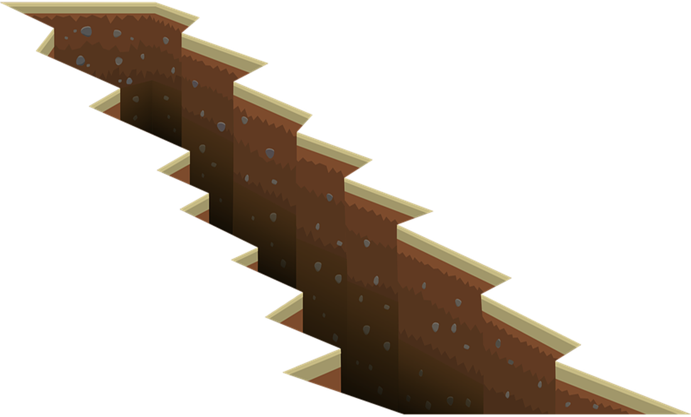

Skill 22: 2 Way Frequency Tables
Work together to solve your problems.
NO PEEKING
You will be graded based on the color of your pen

Slide 3
Name:
Pen color:
Problem 1
Problem 2

Slide 4
Name:
Pen color:
Problem 3
Problem 4

Slide 5
Fractions
Question Cards
Facts Cards
Answer Key

Slide 6
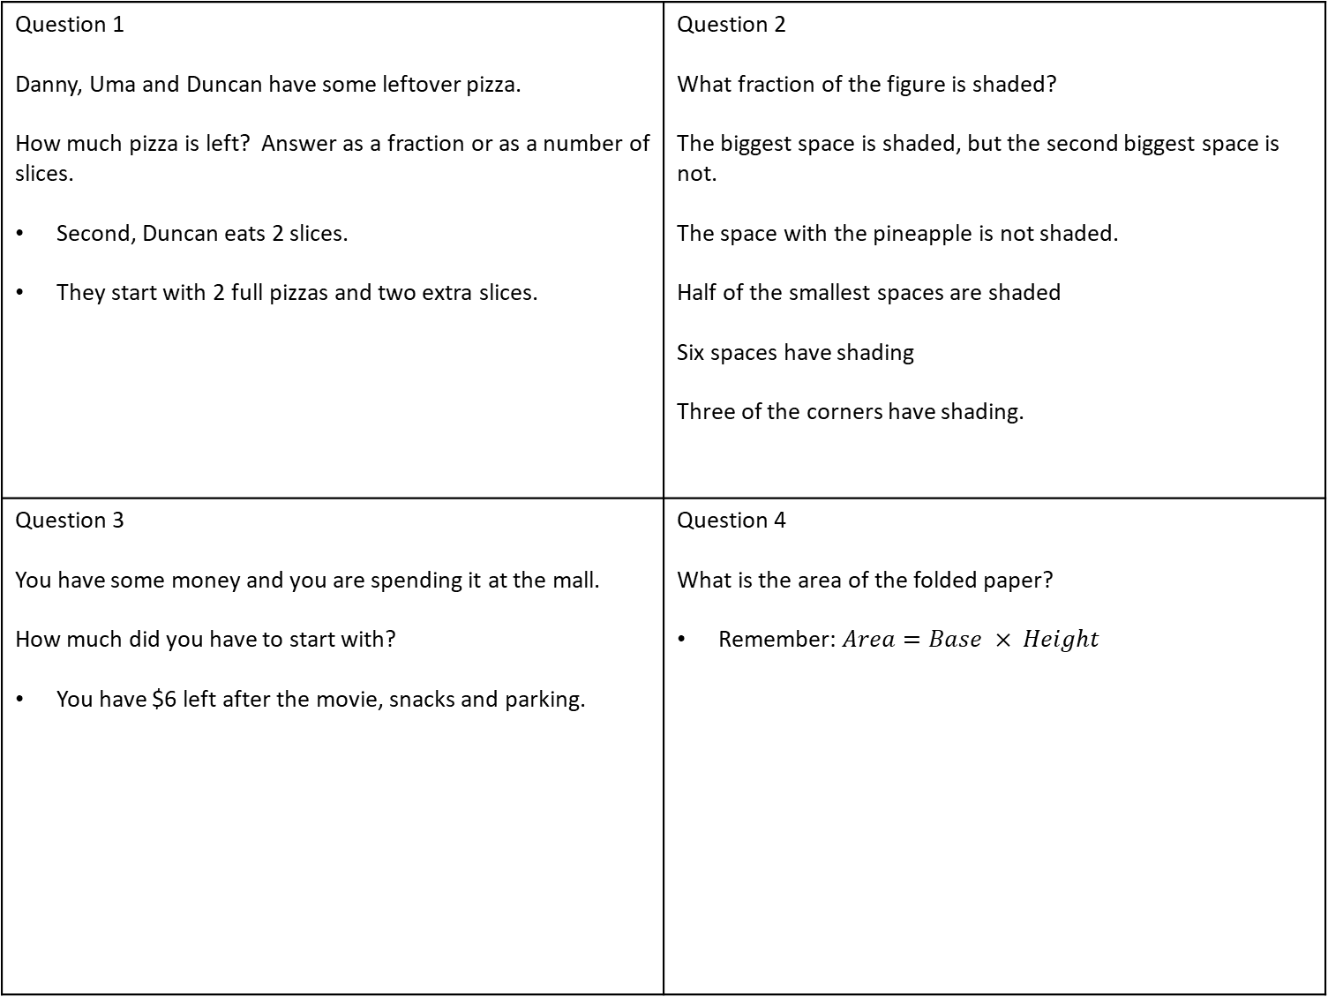
Question 1 Danny, Uma and Duncan have some leftover pizza. How much pizza is left? Answer as a fraction or as a number of slices. Second, Duncan eats 2 slices. They start with 2 full pizzas and two extra slices. | Question 2 What fraction of the figure is shaded? The biggest space is shaded, but the second biggest space is not. The space with the pineapple is not shaded. Half of the smallest spaces are shaded Six spaces have shading Three of the corners have shading.
Question 3 You have some money and you are spending it at the mall. How much did you have to start with? You have $6 left after the movie, snacks and parking. | Question 4 What is the area of the folded paper? Remember: $Area=Base × Height$

Slide 7
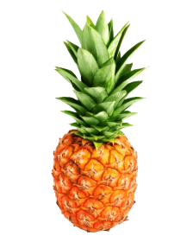
Facts Each pizza is cut up into 8 equal slices First, Danny eats two ninths of the pizza Third, Uma eats one fourth of the remaining pizza | Facts
Facts First, You spend one fourth of your money on a movie ticket. After paying for the movie, you spend one half of your remaining money on snacks. After paying for snacks, you spend three dollars to validate parking. | Facts A normal sheet of paper measures 8.5 inches by 11 inches. You fold it in half once. And twice. And three times.
Every space is completely shaded, or not shaded at all.

Slide 8
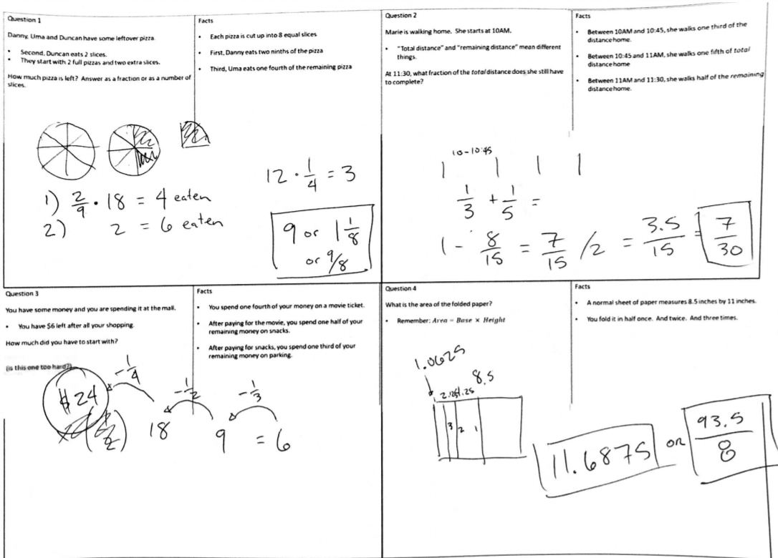
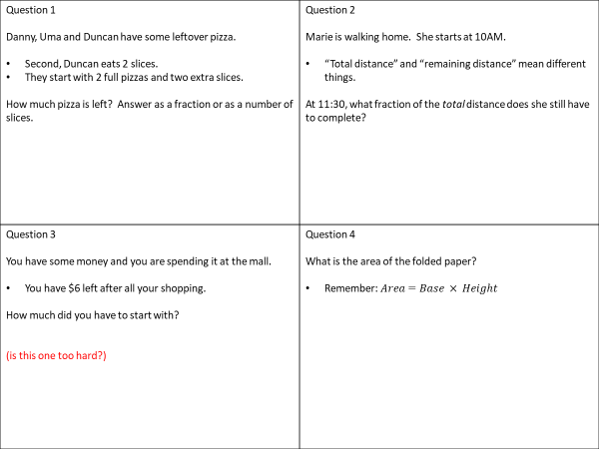
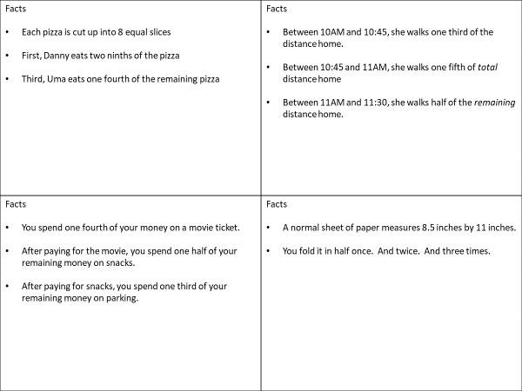

Slide 9
Similarity
Question Cards
Facts Cards
Answer Key

Slide 10
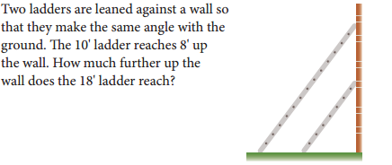
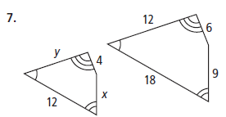
Question 1 How much higher does the 18 foot ladder reach? The picture below might help: | Question 2 Find the value of “x” and the value of “y”
Question 3 How many feet tall is the tower? The tower casts a shadow that is 11.3 yards long. | Question 4 What is the length of the longest side of triangle QRS? The smallest side of QRS is 280.

Slide 11
Facts The two ladders are leaned against the wall so they make the same angle with the ground. There are two ladders. One is an 18 foot ladder and the other is ten feet. The ten foot ladder reaches 8 feet up the wall | Facts This shape is similar to the one on the question sheet:
Facts Josué is 5.4 feet tall. Josué casts a shadow that is 8.7 feet long. There are 3 feet in one yard | Facts You should DRAW the triangles. Triangles EFG and QRS are similar EFG has sides that are 144, 128 and 112. Did you DRAW the triangles?

Slide 12
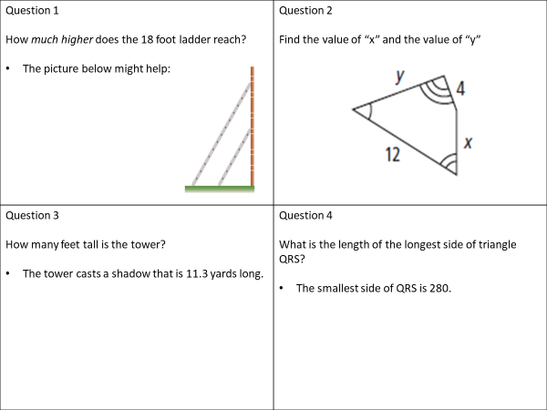
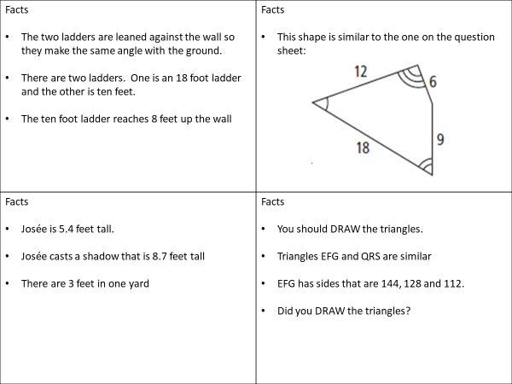
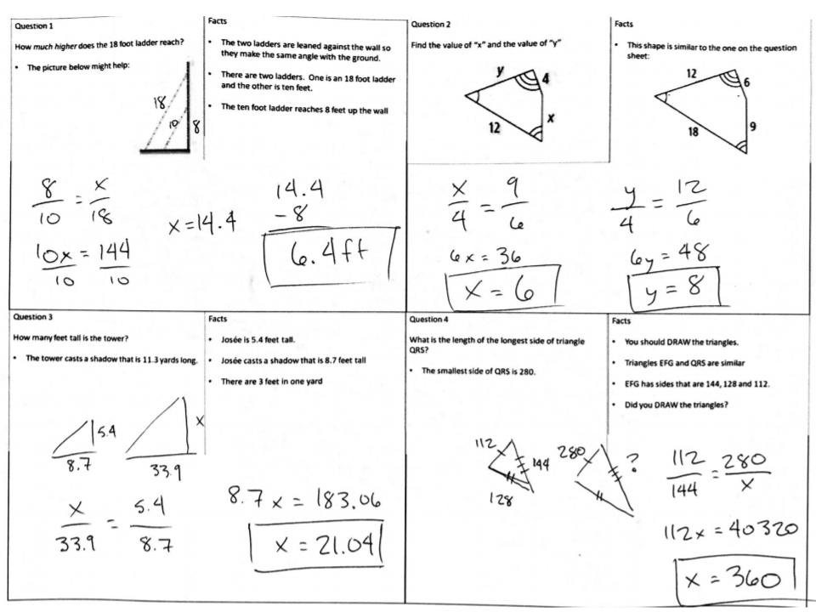

Slide 13
Exponential Patterns
Question Cards
Facts Cards
Answer Key

Slide 14
Question 1 E. Coli is a very strong bacteria used in many scientific studies. How many bacterium do you have after 3 hours in ideal conditions? You must create an equation for full credit | Question 2 Tony Hawk is draining a pool so he can use it as a halfpipe. How much water did it start with? After 10 hours, there are 13,000 gallons left.
Question 3 Maya has invested $1000 in an account that gives interest. How much does she have now? | Question 4 Radioactive Polonium (Po-210) was used by the Russian government to poison a dissident in 2018. You started with 40 grams of Po-210 in your lab. How much is there now?

Slide 15
Facts E.Coli reproduces very quickly. In ideal conditions, the number of bacterium double every 20 minutes. At the start of your experiment, the sample you started with contained 200 individual bacteria. | Facts After 24 hours, there are 10,200 gallons left in the pool. It is draining at a constant rate.
Facts It has been 9 years since she invested her money. Maya’s return from the bank is 8% annually. How could you make this into a constant multiplier? (Hint: it’s not x8) | Facts 966 days have passed since you started your polonium experiment. Po-210 has a half-life of 138 days. This means half of your sample decays every 138 days.

Slide 16
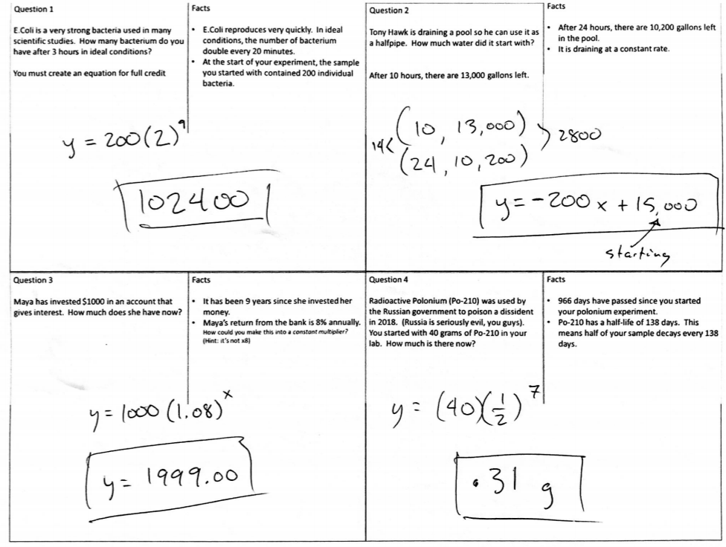

Slide 17
Two Way Frequency Tables
Question Cards
Facts Cards
Answer Key

Slide 18
Question 1 The Green-tangle neighborhood has 620 high school age students and 210 middle school age students. What percent of those students attend a private school? | Question 2 You are in charge of scheduling math classes for 9th and 10th grade at Sue Bird High School. How many sections of Algebra 1, Geometry and Algebra 2 should you plan for? (I want three answers to this question, one for each class)
Question 3 There are 75 orca whales left in the Puget sound. They live in families called “pods” and Puget sound is home to the J-pod, K-pod and L-pod. Copy and complete the following table. | Question 4 A butterfly sanctuary has 108 Monarch butterflies and 94 Viceroy butterflies. If you catch one butterfly, what is the percent chance that butterfly is a female Monarch?
 | J-pod | K-pod | L-pod
Male |  |  |  | 37
Female
 | 23

Slide 19
Facts Green-tangle neighborhood student data: | Facts Sue Bird high school has classes of 30 max. There are 55 kids who need Algebra 1 41 10th graders need geometry and 21 need Algebra 2. Some need Algebra 1 also. 42 9th graders need Algebra 1. 6 need Algebra 2. There are 65 9th graders.
Facts J-pod and K-pod have the same number of males. 45.33% of the whales live in L-pod. L-pod is the only pod with equal number of males and females. | Facts 110 butterflies are male. There are 14 more male Viceroy butterflies than male Monarch butterflies
 | Private | Public
Middle |  | 150
High |  | 502

Slide 20
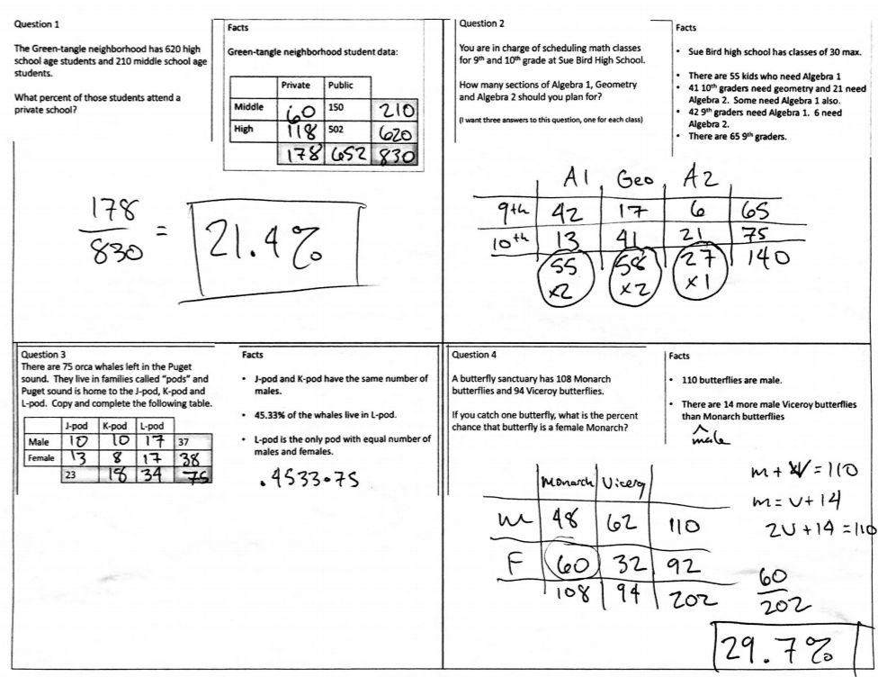

Slide 21
Systems of Equations
Question Cards
Facts Cards
Answer Key

Slide 22
Question 1 Hilda owns her own landscaping company. She mows two types of lawns: residential (i.e. houses) and commercial (businesses). How many residential accounts does she have? How many commercial accounts does she have? | Question 2 One stock costs $35 per share and another costs $45 per share. How many of each stock did the investor buy?
Question 3 How much do the hats cost? What about the gloves? Tori bought two pairs of gloves and two hats. | Question 4 Mr. Nguyen has some money he wants to split between his daughters. How much does each one get? The oldest gets twice as much as the youngest.

Slide 23
Facts Each week, she mows a total of 120 lawns Her weekly income from all lawns is $2620 Hilda’s rates are as follows: Commercial lawns: $40 Residential lawns: $20 | Facts The investor spent a total of $15000 The investor bought a total of 360 shares.
Facts Cody bought two pairs of gloves and four hats for $43 Tori spent $30 total. | Facts This problem is spicy Mr. Nguyen has three daughters. The middle daughter gets $35 more than the youngest daughter. There is $775 to split

Slide 24
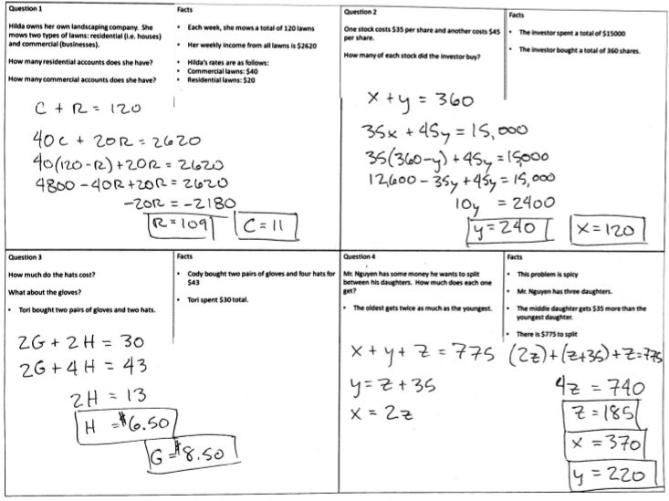
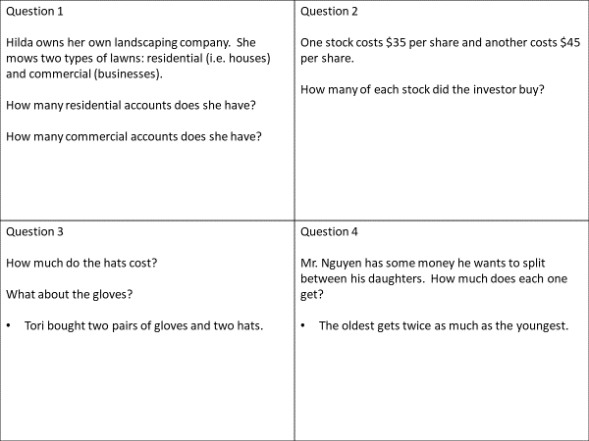
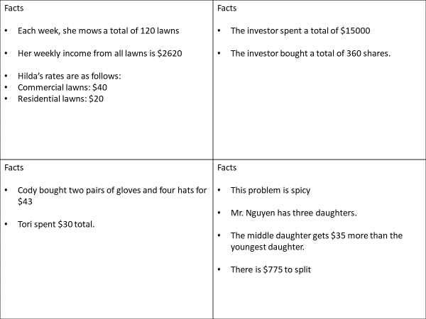

Slide 25
Linear Patterns
Question Cards
Facts Cards
Answer Key

Slide 26
Question 1 Walter is selling rock candy. How much money did he have to start with? How much money would he have after selling 22 candies? After selling 5 candies, he has 15 dollars. | Question 2 Flipper is filling a pool with water. The pool holds 500 gallons, so how long from the time Flipper started filling the pool will it take until the pool is full?
Question 3 A rental car company charges a flat daily rate, plus $0.15 per mile. How much will it cost to rent the car if you drive from Seattle to Tacoma and back? | Question 4 You and a friend are starting a pet washing sevice. “cost” and “start with” mean different things. How many pets do you need to wash to make $20?

Slide 27
Facts After selling three candies, Walter has eleven dollars (3,11) He started with some money in his bank account. | Facts After six hours, there are 250 gallons in the pool. After 10 hours, there are 370 gallons in the pool
Facts The daily rate is $19.95 and there is a charge per mile on top of that. Seattle to Bellingham is 89 miles Seattle to Tacoma is 33 miles Seattle to Spokane is 280 miles | Facts You plan to charge $5 per pet. Supplies cost $30

Slide 28
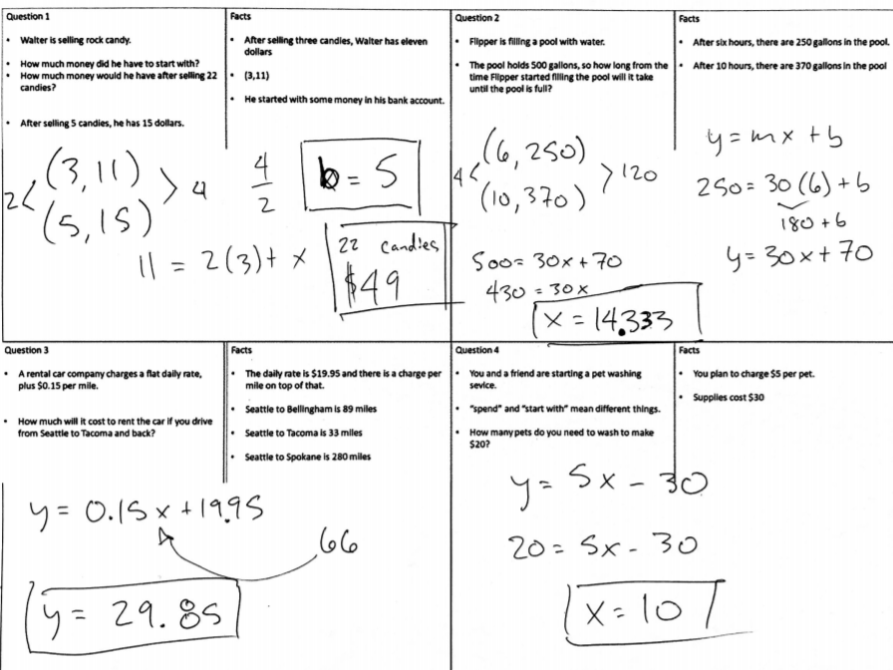
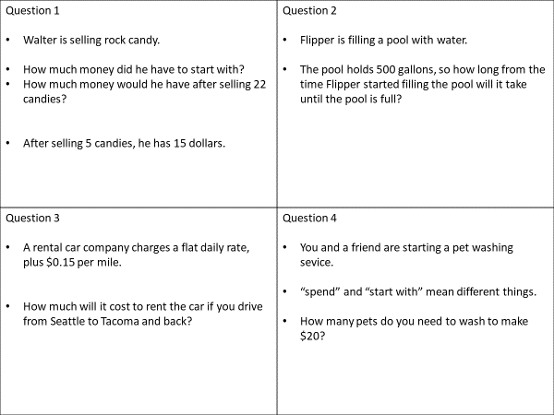
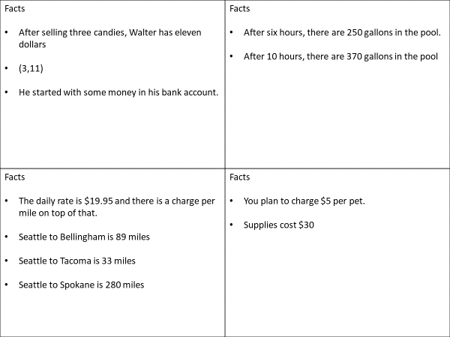

Slide 29
Congruent Triangle Proofs
Question Cards
Facts Cards
Answer Key

Slide 30
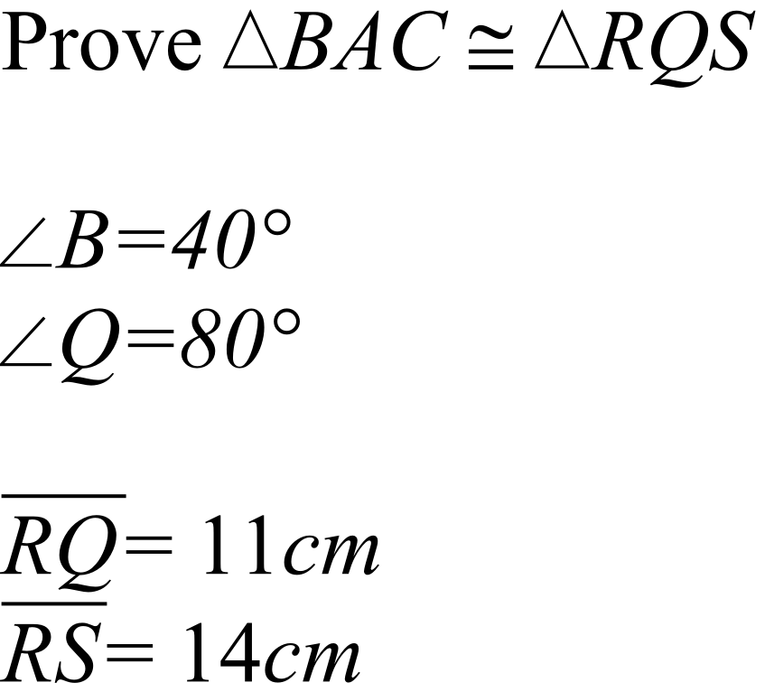
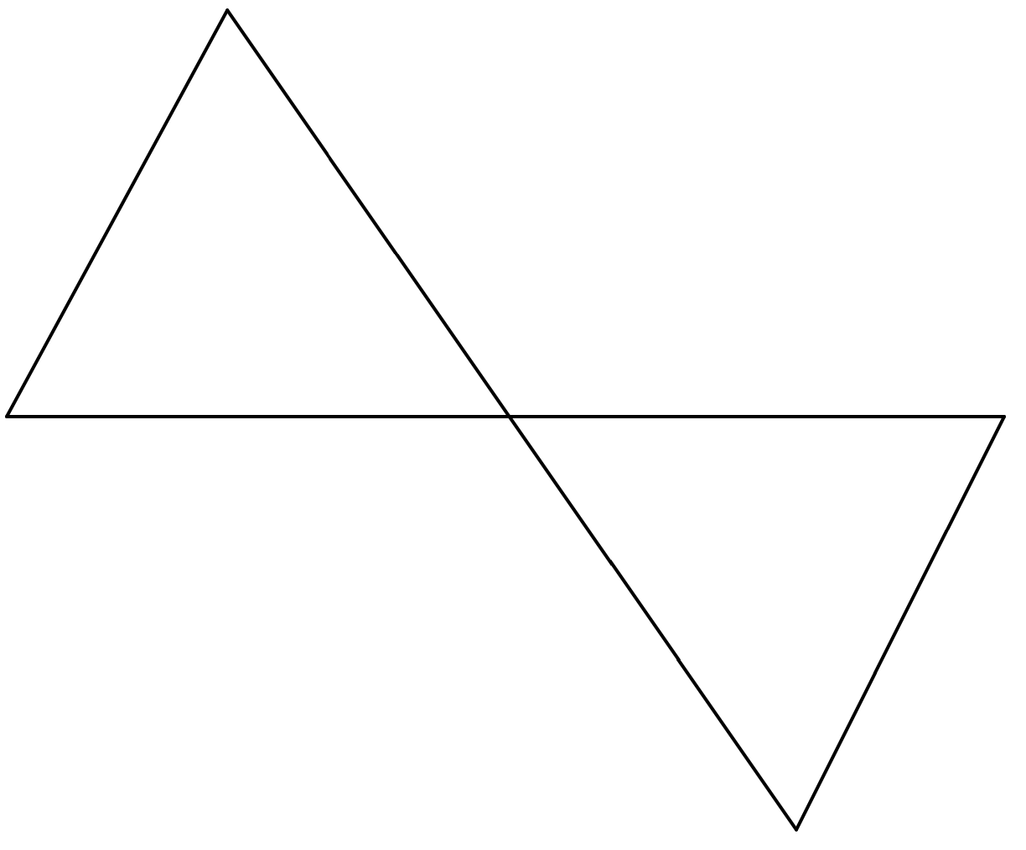
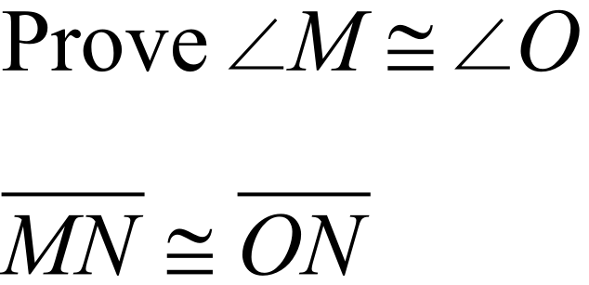






Question 1 Prove these triangles are congruent. | Question 2
Question 3 | Question 4

Slide 31
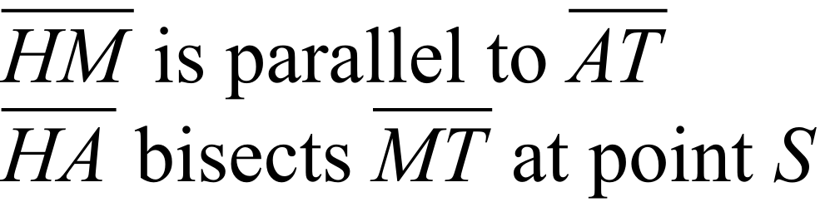
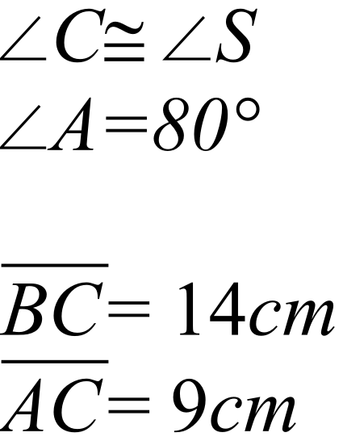
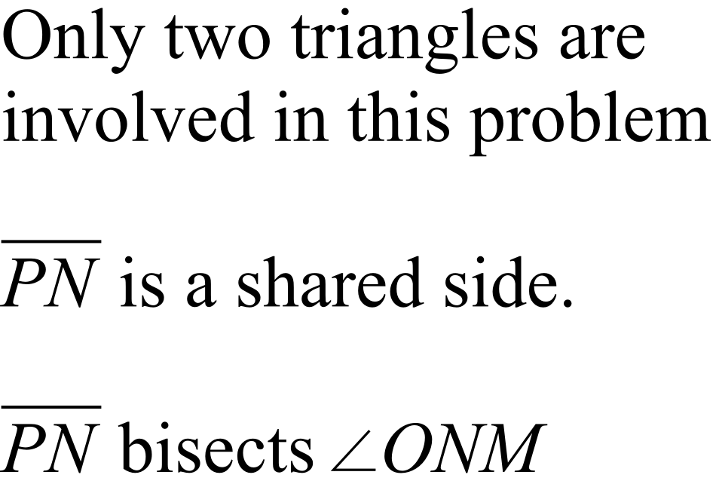
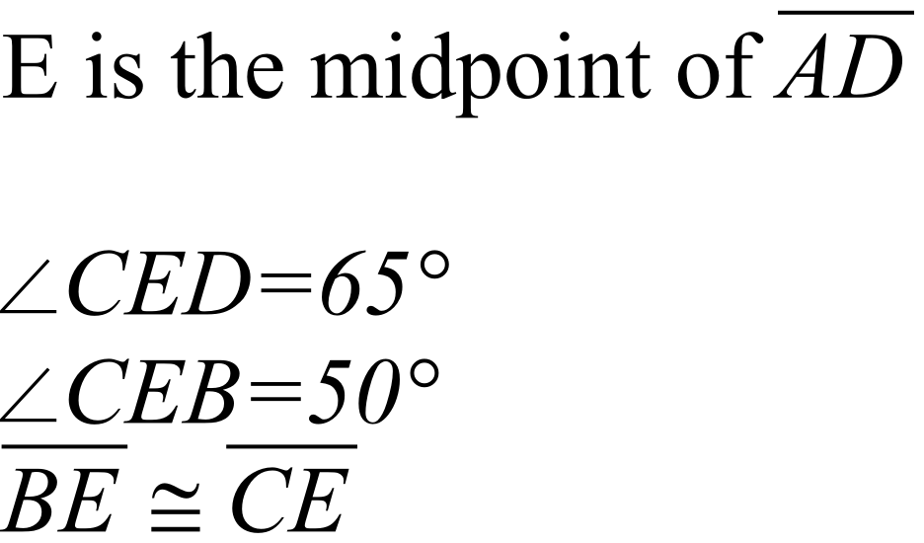
Facts | Facts
Facts | Facts

Slide 32
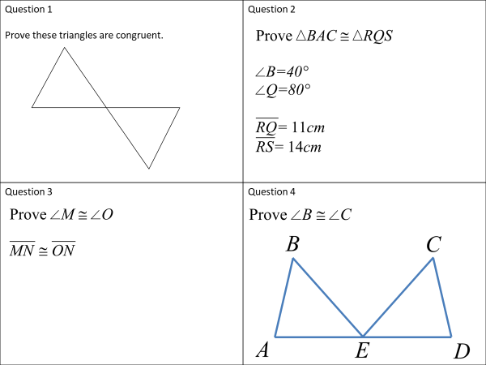
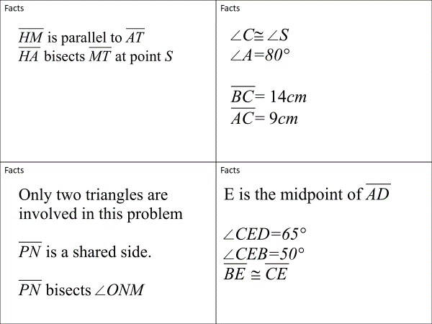
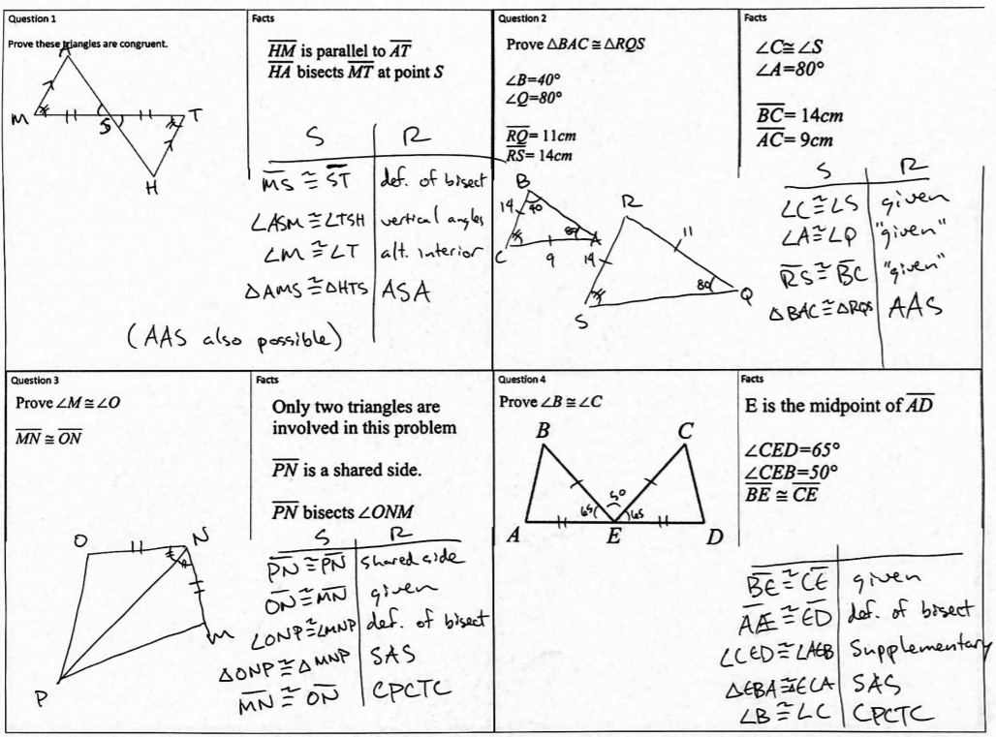

Slide 33
Arcs And Sectors
Question Cards
Facts Cards
Answer Key

Slide 34
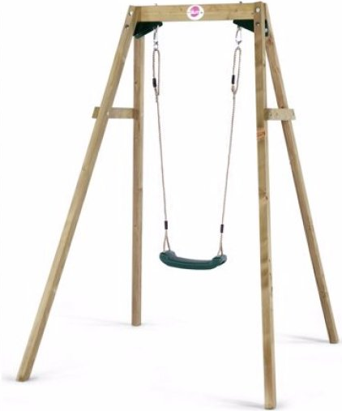
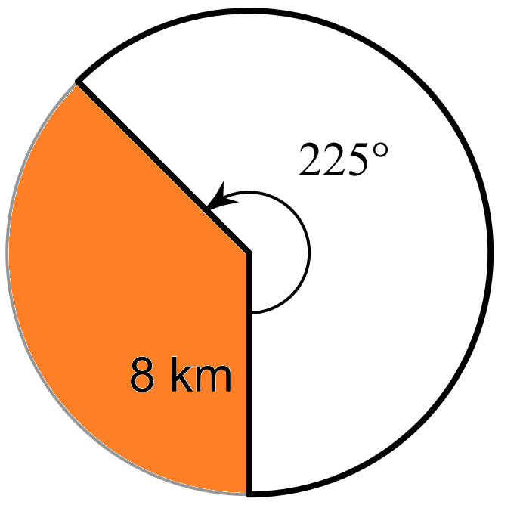
Question 1 Jackie is going to perform a relay handoff to Florence on a circular track. How many meters does Jackie need to run to pass the baton to Florence? The radius of the track is 51 meters. Both runners will be running clockwise. | Question 2 Fernanda’s car has windshield wipers. What is the area of windshield that they clean? The wipers overlap in the middle The area where the wipers overlap can be measured to be 98 square inches.
Question 3 How far will a swinging child travel on this swing? | Question 4 Which shaded area is bigger?

Slide 35
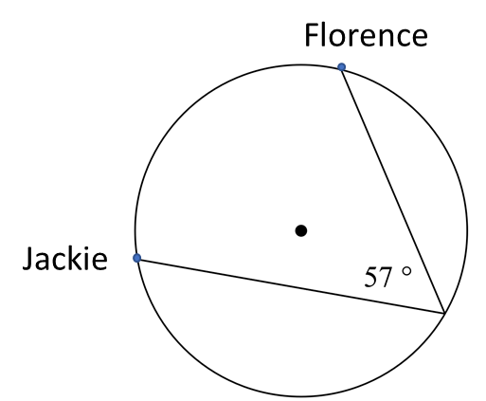
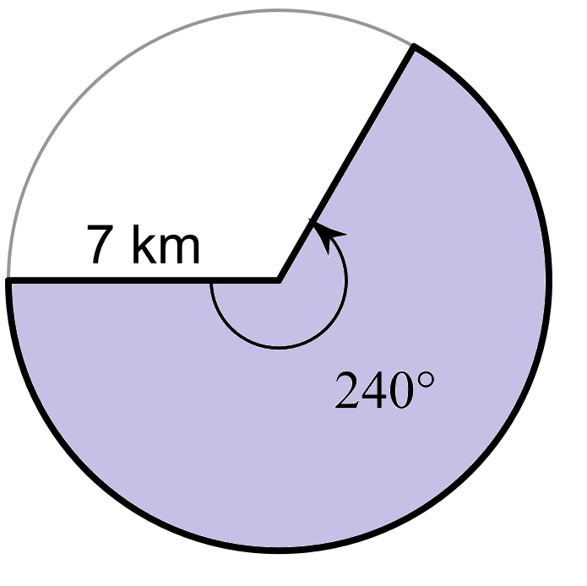
Facts A third runner standing across the track from Jackie and Florence makes this measurement: | Facts Is this an area or circumference question? Each wiper is 21 inches in length Each wiper travels in a path that is 110°
Facts The distance between the seat and the swing-set frame is 11 feet. The swing traces a circular path that represents 34° of a circle. | Facts

Slide 36
