Slide 1

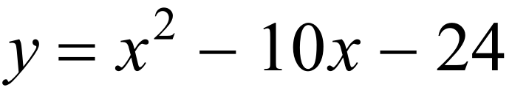
Find the solutions…

Slide 2
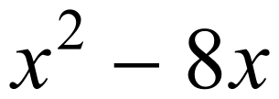
Find the solutions…

Slide 3
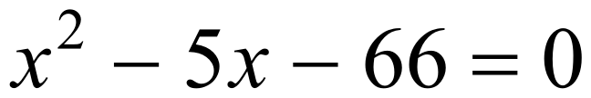
Find the solutions…

Slide 4
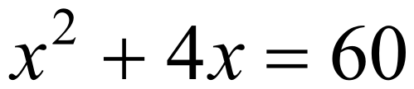
Find the solutions…

Slide 5
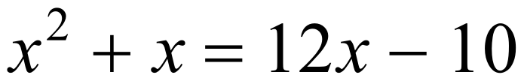
Find the solutions…

Slide 6
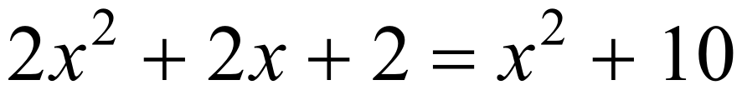
Find the solutions…

Slide 7
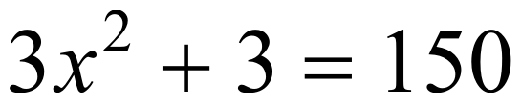
Find the solutions…

Slide 8
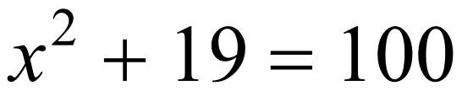
Find the solutions…

Slide 9
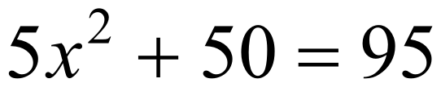
Find the solutions…

Slide 10
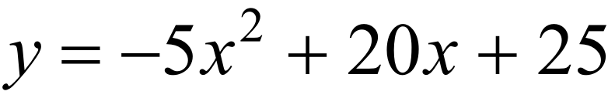
Find the solutions…

Slide 11
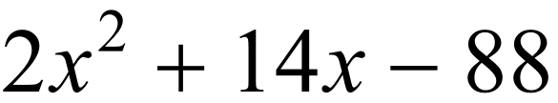
Find the solutions…

Slide 12
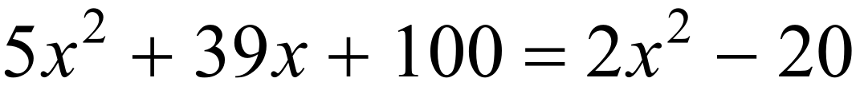
Find the solutions…

Slide 13
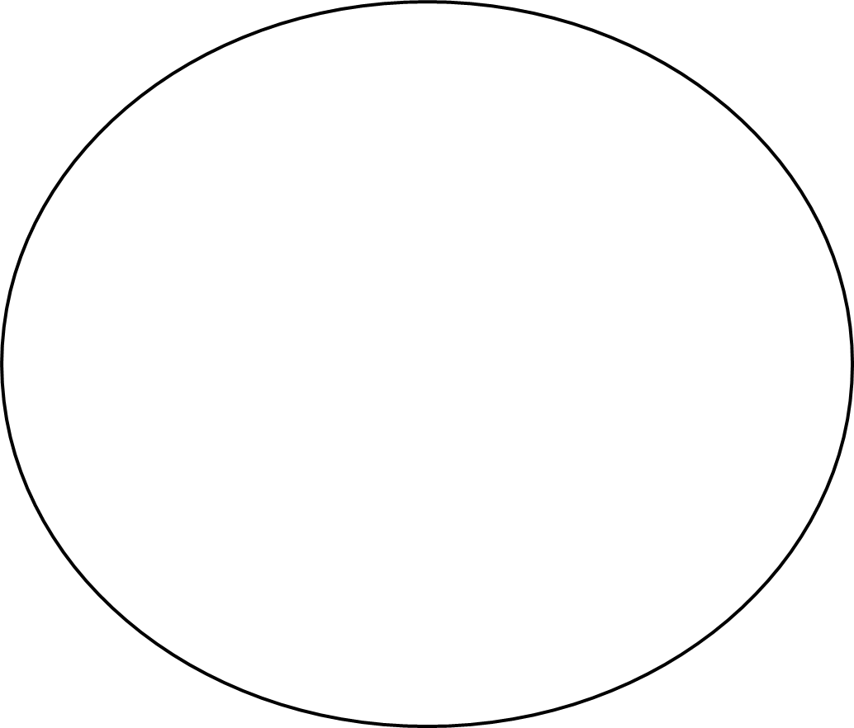
Card 1
8 | 3 | 2 | -5 | 6
5 | 0 | 10 | -8 | -11
-9 | -7 | FREE | 12 | -3
4 | 7 | 11 | 1 | -1
-6 | -10 | -2 | 9 | 4

Slide 14
Card 2
3 | -5 | -11 | -6 | 10
-7 | 2 | 8 | -2 | 11
6 | 1 | FREE | -8 | -10
-1 | 7 | 5 | -3 | -9
0 | 9 | 4 | -4 | 12

Slide 15
Card 3
11 | -9 | 3 | 8 | 12
-5 | 7 | 4 | -7 | -1
-6 | 5 | FREE | -11 | 2
0 | 1 | -3 | -2 | 10
6 | -4 | -8 | 9 | -10

Slide 16
Card 4
-1 | -10 | -2 | -8 | 7
1 | 6 | 2 | 3 | 5
10 | 0 | FREE | -3 | -4
8 | -6 | -5 | -7 | -9
-11 | 4 | 9 | 11 | 12

Slide 17
Card 5
0 | -5 | 11 | 10 | 1
8 | -11 | -1 | 12 | 9
-8 | 5 | FREE | -9 | 6
-4 | 3 | 2 | -3 | -2
-10 | 4 | 7 | -7 | -6

Slide 18
Card 6
9 | 5 | -6 | -10 | -2
3 | 2 | 12 | 10 | 0
1 | -5 | FREE | -1 | -4
4 | -8 | -9 | -3 | -7
6 | 8 | -11 | 7 | 11

Slide 19
Card 7
7 | 1 | 4 | 6 | -4
-2 | -6 | 5 | 8 | -7
11 | -3 | FREE | -11 | -1
-8 | -10 | 10 | -9 | 0
3 | -5 | 9 | 2 | 12

Slide 20
Card 8
-6 | -2 | 12 | -1 | -3
-9 | -4 | -8 | 1 | 3
5 | 11 | FREE | -7 | 8
4 | -5 | 7 | -11 | 6
0 | 9 | 2 | 10 | -10

Slide 21
Card 9
-10 | 9 | 6 | -11 | -7
2 | -4 | 0 | 1 | 7
-5 | 11 | FREE | 12 | -1
4 | 5 | 8 | -9 | 10
3 | -6 | -8 | -2 | -3

Slide 22
Card 10
0 | -10 | 6 | -7 | 12
-9 | 4 | -6 | 1 | 7
2 | 5 | FREE | 3 | -1
-4 | 8 | 10 | 11 | -2
-3 | 9 | -8 | -11 | -5

Slide 23
Card 11
4 | -5 | 2 | -10 | -6
-3 | 1 | -2 | 9 | -7
-1 | 7 | FREE | 12 | 11
0 | 10 | 6 | -4 | -9
-11 | 5 | 3 | 8 | -8

Slide 24
Card 12
0 | -8 | 10 | -6 | 11
-4 | 7 | 4 | -11 | 9
12 | -10 | FREE | -2 | -1
-7 | -9 | 2 | -3 | 6
-5 | 8 | 5 | 1 | 3

Slide 25
Card 13
-4 | -3 | 1 | 8 | -11
0 | -8 | -7 | -1 | 6
5 | 2 | FREE | -6 | 4
9 | -5 | 3 | -9 | -2
11 | 7 | -10 | 12 | 10

Slide 26
Card 14
10 | 8 | 3 | -10 | -9
4 | -5 | -6 | -11 | 6
1 | 12 | FREE | -3 | 7
-1 | 11 | 0 | 9 | -8
-2 | 5 | -4 | -7 | 2

Slide 27
Card 15
-2 | -10 | 9 | 12 | -8
-5 | -11 | -9 | -1 | -4
1 | 2 | FREE | 10 | -6
5 | 7 | 8 | -7 | 11
3 | 4 | 6 | -3 | 0

Slide 28
Card 16
0 | -5 | -3 | 7 | -6
-11 | 11 | -1 | 8 | -2
-8 | 4 | FREE | -9 | 3
5 | 9 | 1 | 12 | 2
6 | -4 | -10 | -7 | 10

Slide 29
Card 17
7 | 12 | -8 | -4 | -3
1 | -9 | -7 | 11 | 2
4 | 8 | FREE | -6 | -5
6 | 3 | -11 | -2 | 10
-10 | -1 | 0 | 9 | 5

Slide 30
Card 18
-2 | -3 | -6 | 4 | -9
8 | 11 | 5 | 10 | -4
7 | -1 | FREE | -5 | 12
1 | 9 | 3 | 2 | -8
-7 | 6 | -11 | -10 | 0

Slide 31
Card 19
0 | 2 | -7 | 11 | 12
-8 | -5 | -10 | 8 | -4
-3 | 1 | FREE | -2 | 4
-1 | -9 | 9 | 3 | 5
6 | 10 | -11 | -6 | 7

Slide 32
Card 20
-11 | 2 | -1 | 11 | -6
10 | 9 | 7 | 12 | 1
5 | 3 | FREE | 0 | -3
4 | 6 | -2 | -4 | 8
-8 | -5 | -10 | -7 | -9

Slide 33
Card 21
6 | -10 | 0 | -7 | 3
-2 | 4 | 7 | 2 | -8
8 | -6 | FREE | -11 | 11
-4 | 10 | -1 | 12 | -3
-5 | -9 | 5 | 1 | 9

Slide 34
Card 22
-1 | 9 | -8 | -3 | 3
0 | 4 | -10 | -4 | -11
11 | 7 | FREE | -2 | 6
-9 | 1 | 8 | -7 | -5
10 | 12 | 5 | 2 | -6

Slide 35
Card 23
-3 | 12 | -8 | -1 | 1
-9 | 7 | 5 | -2 | 2
-6 | 9 | FREE | 4 | 0
3 | -11 | 10 | -7 | 8
6 | 11 | -4 | -5 | -10

Slide 36
Card 24
0 | -5 | 11 | 10 | 1
8 | -11 | -1 | 12 | 9
-8 | 5 | FREE | -9 | 6
-4 | 3 | 2 | -3 | -2
-10 | 4 | 7 | -7 | -6

Slide 37
Card 25
5 | 2 | 7 | -3 | -1
9 | -7 | 12 | -10 | 10
-6 | 1 | FREE | -11 | 4
-5 | 8 | 6 | -4 | 11
3 | 0 | -2 | -8 | -9

Slide 38
Card 26
-5 | -4 | 0 | 4 | -10
5 | 10 | 1 | -7 | -11
2 | -8 | FREE | 7 | 6
12 | -2 | -6 | 11 | 8
9 | -9 | 3 | -1 | -3

Slide 39
Card 27
10 | 0 | 8 | -8 | 1
-11 | 2 | 3 | 11 | 7
6 | 5 | FREE | -6 | -9
-3 | -4 | -7 | 9 | -2
4 | -10 | -1 | 12 | -5

Slide 40
Card 28
11 | 6 | -4 | -2 | 2
-9 | 10 | -11 | 0 | -8
7 | 5 | FREE | -6 | -7
9 | -10 | 12 | -1 | 3
-3 | -5 | 4 | 1 | 8

