Slide 1

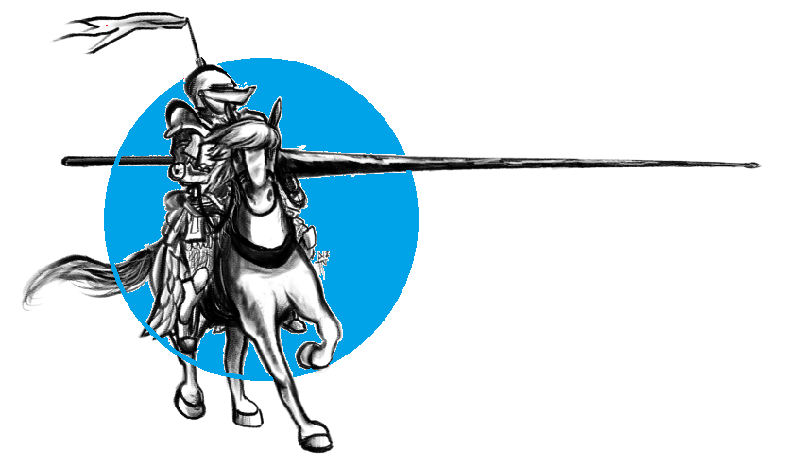
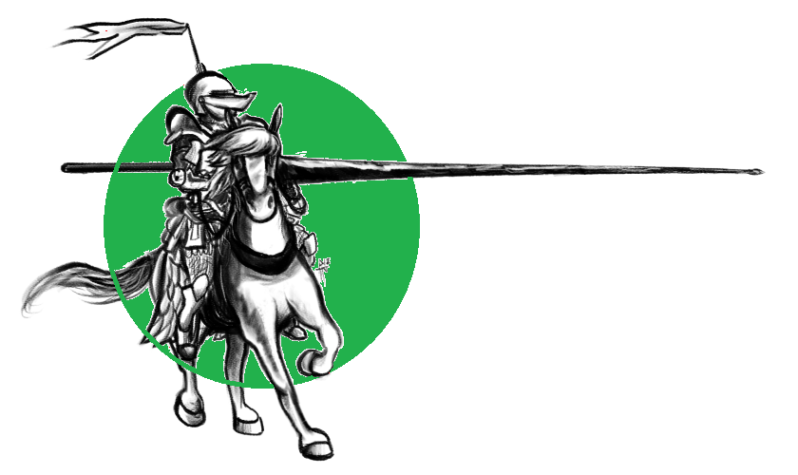




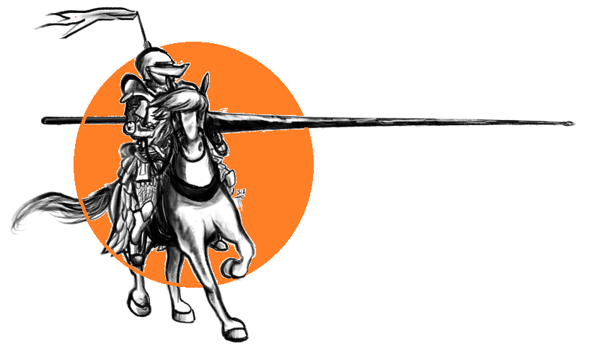
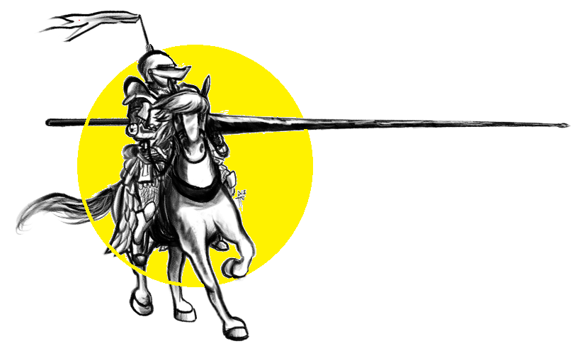
Red
Black
Green
Blue
Green
Mean
Mode
Mean
Outlier
Median
Median
Mean
Median
Range
Minimum

Slide 2
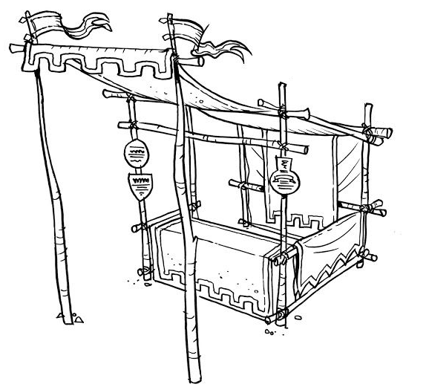

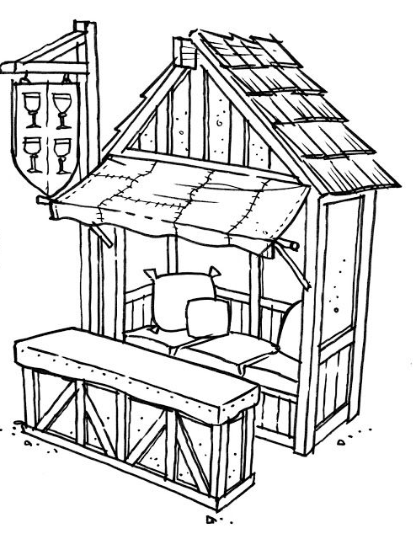
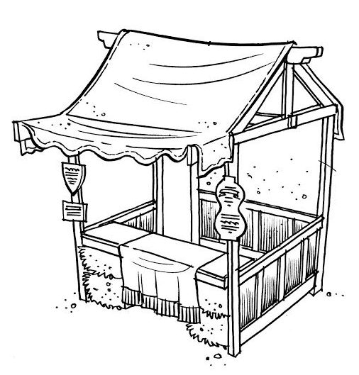
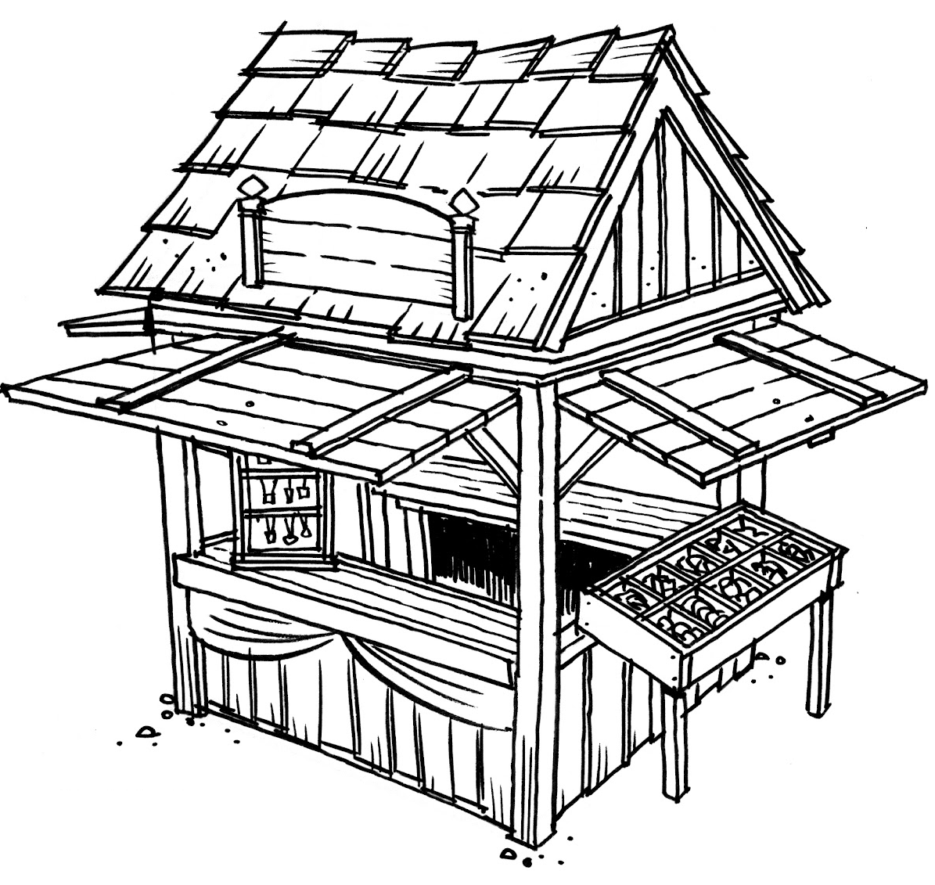
Yearly Rainfall, New Orleans Louisiana
2010 | 54 |  | 2017 | 72
2011 | 55 |  | 2018 | 61
2012 | 68
2013 | 66
2014 | 55
2015 | 71
2016 | 70
*For reference: Seattle gets about 38 inches of rain per year.

Slide 3
USA Flu Deaths by year (in 1,000s)
2010 | 37 |  | 2017 | 61
2011 | 12 |  | 2018 | 34
2012 | 43
2013 | 38
2014 | 51
2015 | 23
2016 | 38
*Even though this data is measured in 1000’s, please treat these numbers as two digit numbers, for the sake of this exercise.

Slide 4
Ages of Presidents on First day in office
George Washington | 57
John Adams | 61
Thomas Jefferson | 57
James Madison | 57
James Monroe | 58
John Q Adams | 57
Andrew Jackson | 61
*For reference: Donald Trump was 70 years old when he was elected (Oldest first term president). Barack Obama was 47 (fifth youngest first term president).

Slide 5
Height: 1995 Seattle Supersonics (in inches)
Vincent Askew | 78 |  | Gary Payton | 76
Frank Brickowski | 81 |  | Sam Perkins | 81
Sherell Ford | 79 |  | Steve Scheffler | 81
Hershey Hawkins | 75 |  | Detlef Schrempf | 81
Ervin Johnson | 83 |  | Eric Snow | 75
Shawn Kemp | 82 |  | David Wingate | 77
Nate McMillan | 77
*1995 Western Conference Champions

Slide 6
Life Expectancy (N. America)
Canada | 83 |  | Barbados | 76
Cuba | 79 |  | Antigua | 75
United States | 78 |  | Dominican Rep. | 74
Mexico | 77 |  | Grenada | 73
Jamaica | 76 |  | Saint Vincent | 72
Bahamas | 76 |  | Trinidad/ Tobego | 72
Saint Lucia | 76 |  | Haiti | 64

Slide 7
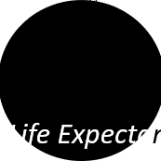
Life Expectancy (S. America)
Chile | 79 |  | Paraguay | 74
Uraguay | 77 |  | Venezuela | 74
Argentina | 76 |  | Suriname | 71
Ecuador | 76 |  | Bolivia | 71
Peru | 75 |  | Guyana | 66
Brazil | 75
Columbia | 75

Slide 8
Number of players
on Active Roster, Cleveland Browns
2014 | 53
2015 | 53
2016 | 53
2017 | 53
2018 | 53
2019 | 53
*Guess what it’s going to be in 2020…

Slide 9



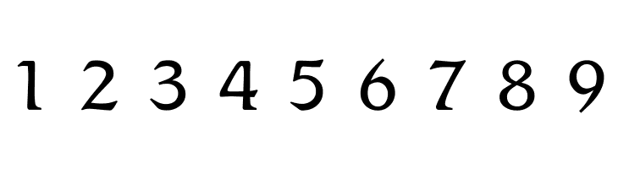









What percent of the dukes walk to school?
2368
What percent of all students ride to school?
What percent of all students are non- binary and ride to school?
What percent of all students are dukes?
What percent of the students who walk to school are dames?

Slide 10
You conduct a poll of a group of medieval students to see how they get to medieval high school. 112 students are polled. 50 of the students are dames, some are dukes, and 4 are non-binary. An equal number of the dame students ride horses (compared to the number who walk). 24 dukes ride horses.
 | Ride Horse | Walk
Dukes
Dames
Non-binary

Slide 11


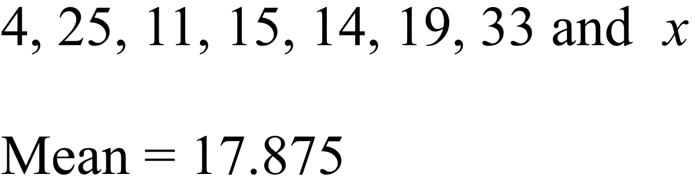



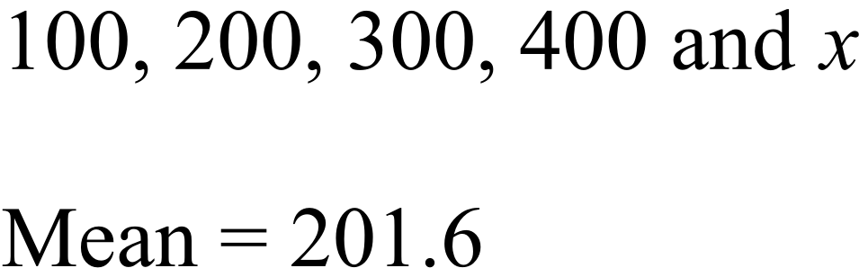
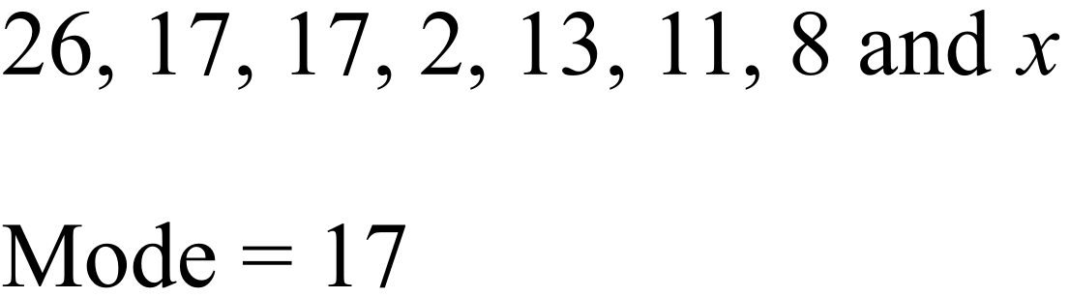

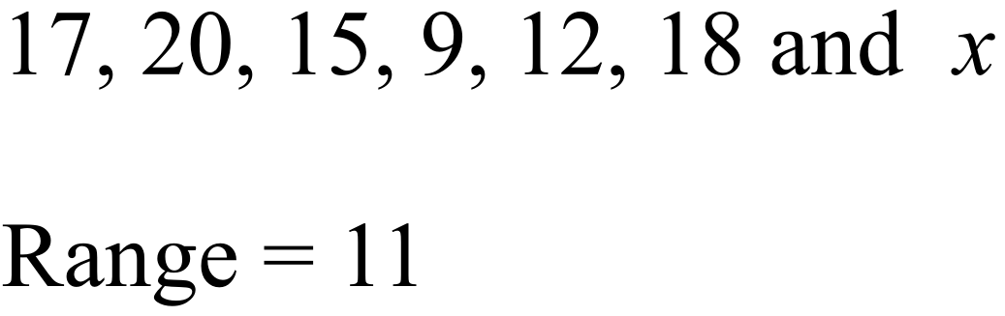
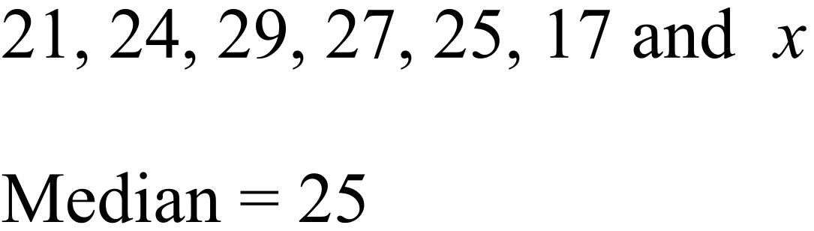
Down
Up
Down
Right
Left
8
26
13
22

Slide 12
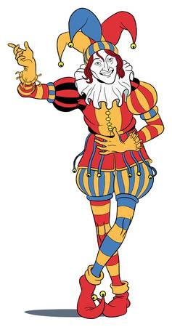

Use the invisible ink pen to write in “why was six afraid of seven”
789

Slide 13
