Slide 1
Algebra Catan Explainer
First three slides are to help explain game
Remainder of slides can be used as question deck for Algebra 1 Semester 1 (according to scope and sequence of my district) and answer key.
You will need gameboards and dice from “Catan Dice” and resource cards from a catan replacement card pack.
Change it however you want!

Slide 2


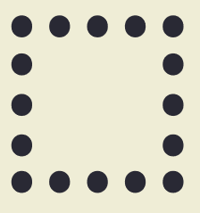

Five teams First to 10 victory points wins
Settlement:
City
Longest Road
Biggest Army

Slide 3

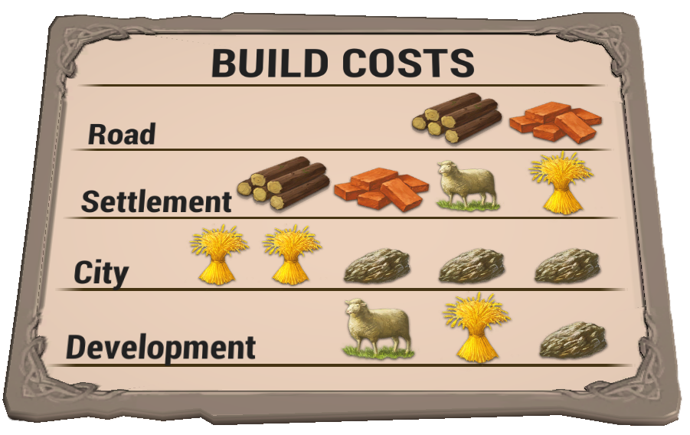
Soldier

Slide 4
Longest Road ___________
Biggest Army ___________

Slide 5


Slide 6
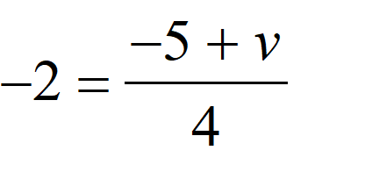
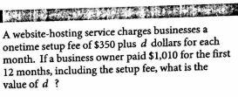
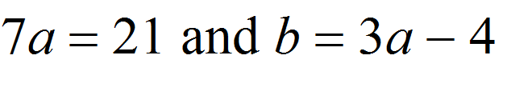
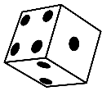

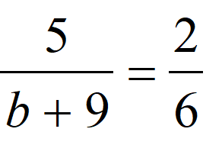
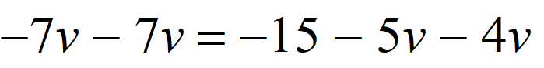
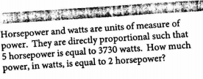
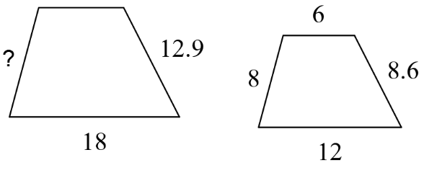
1. Use the following information to solve for “b” | 2. Solve for “v” | 3. SAT Connection
4. Container A and container B have leaks. Container A has 800 ml of water, and is leaking 6 ml per minute. Container B has 1000 ml, and is leaking 10 ml per minute. How many minutes, m, will it take for the two containers to have the same amount of water? | 5. Solve for “v” | 6. Solve for “b”
7. In the first 4 games of the season, a soccer team scored a total of 10 goals. If this trend continues, how many goals can they expect to score in the remaining 18 games? | 8. SAT Connection | 9. Find the missing side length
Skill 1: 1 step equations
Skill 2: 2 step equations
Skill 2: 2 step equations
Skill 3: Variable on both sides
Skill 3: Variable on both sides
Skill 4: Proportions
Skill 4: Proportions
Skill 4: Proportions
Skill 5: Similarity
Skill 5: Similarity
Skill 4: Proportions

Slide 7
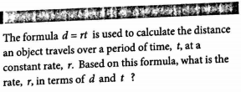
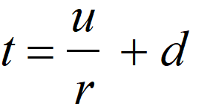
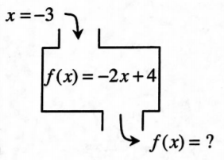
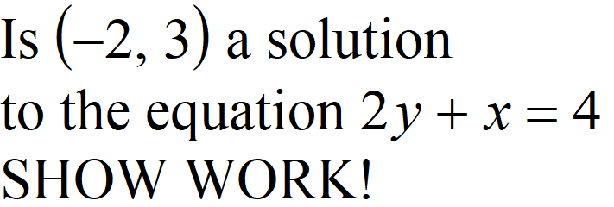
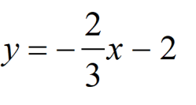
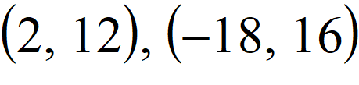

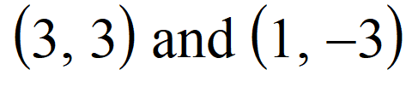
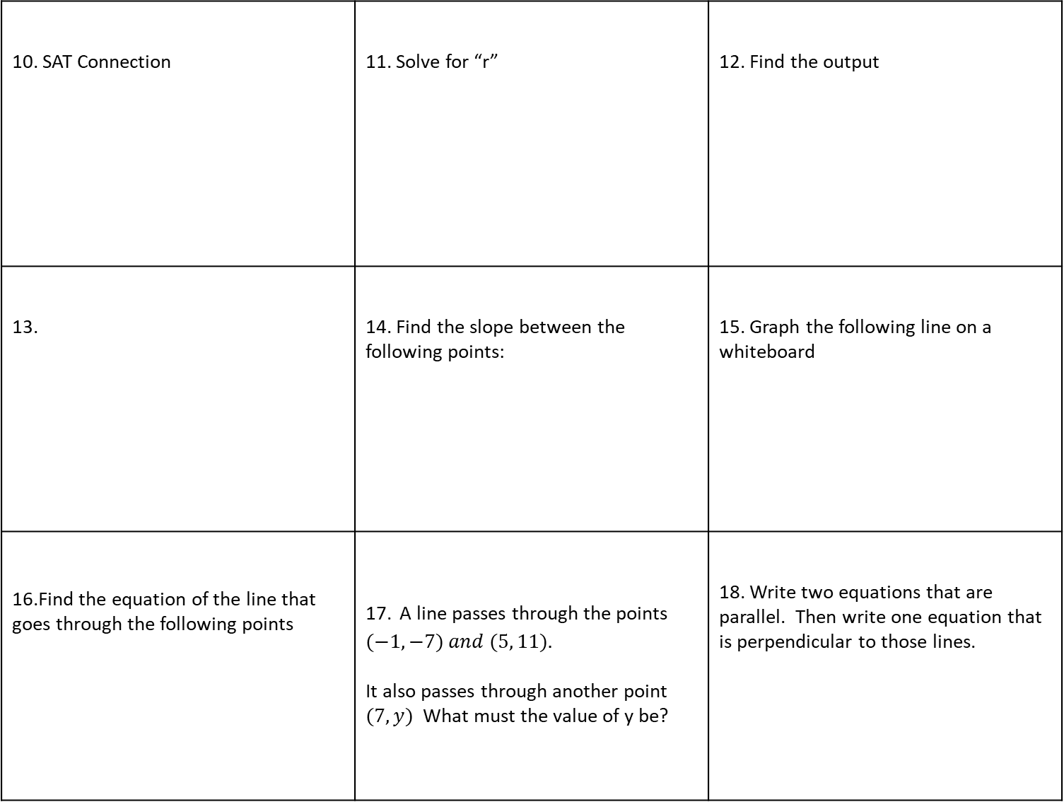
10. SAT Connection | 11. Solve for “r” | 12. Find the output
13. | 14. Find the slope between the following points: | 15. Graph the following line on a whiteboard
16.Find the equation of the line that goes through the following points | 17. A line passes through the points $(−1, −7) and (5, 11).$ It also passes through another point $(7, y)$What must the value of y be? | 18. Write two equations that are parallel. Then write one equation that is perpendicular to those lines.
Skill 6: Formulas
Skill 6: Formulas
Skill 7: Graphing Functions
Skill 7: Graphing Functions
Skill 8: Slope and Y-intercept
Skill 8: Slope and Y-intercept
Skill 9: Equation of a line through two points
Skill 9: Equation of a line through two points
Skill 9: Equation of a line through two points
Skill 9: Equation of a line through two points
Skill 10: Parallel and Perpendicular

Slide 8

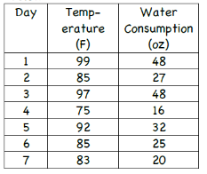
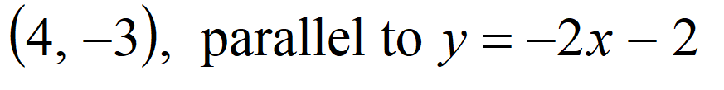

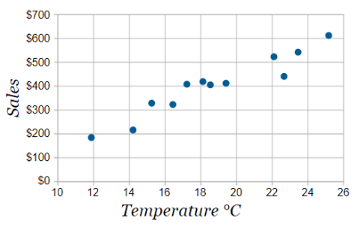
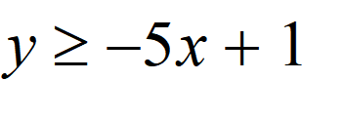
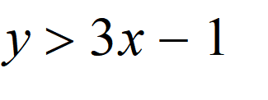
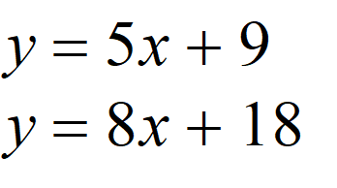
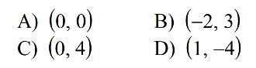
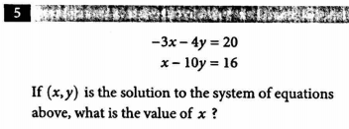
19. Find the equation of the line that goes through the point shown, parallel to the line shown. | 20. Use the following graph to create a scatterplot on your handout. Add a line of bet fit. | 21. Use the following graph on your handout. Draw a line of best fit and calculate the equation from two __________________ perfect points.
22. Graph the following on a white-board | 23. Which of the points below are solutions to the following inequalities? | 24. Find the solution to the following system of equations
25. SAT Connection
Skill 10: Parallel and Perpendicular
Skill 11: Scatterplots
Skill 11: Scatterplots
Skill 12: Inequalities
Skill 12: Inequalities
Skill 13: Systems of Equations
Skill 13: Systems of Equations

Slide 9


Slide 10
1. Use the following information to solve for “b” | 2. Solve for “v” | 3. SAT Connection
4. Container A and container B have leaks. Container A has 800 ml of water, and is leaking 6 ml per minute. Container B has 1000 ml, and is leaking 10 ml per minute. How many minutes, m, will it take for the two containers to have the same amount of water? | 5. Solve for “v” | 6. Solve for “b”
7. In the first 4 games of the season, a soccer team scored a total of 10 goals. If this trend continues, how many goals can they expect to score in the remaining 18 games? | 8. SAT Connection | 9. Find the missing side length
Skill 1: 1 step equations
Skill 2: 2 step equations
Skill 2: 2 step equations
Skill 3: Variable on both sides
Skill 3: Variable on both sides
Skill 4: Proportions
Skill 4: Proportions
Skill 4: Proportions
Skill 5: Similarity
Skill 5: Similarity
Skill 4: Proportions

Slide 11
10. SAT Connection | 11. Solve for “r” | 12. Find the output
13. | 14. Find the slope between the following points: | 15. Graph the following line on a whiteboard
16.Find the equation of the line that goes through the following points | 17. A line passes through the points $(−1, −7) and (5, 11).$ It also passes through another point $(7, y)$What must the value of y be? | 18. Write two equations that are parallel. Then write one equation that is perpendicular to those lines.
Skill 6: Formulas
Skill 6: Formulas
Skill 7: Graphing Functions
Skill 7: Graphing Functions
Skill 8: Slope and Y-intercept
Skill 8: Slope and Y-intercept
Skill 9: Equation of a line through two points
Skill 9: Equation of a line through two points
Skill 9: Equation of a line through two points
Skill 9: Equation of a line through two points
Skill 10: Parallel and Perpendicular

Slide 12
19. Find the equation of the line that goes through the point shown, parallel to the line shown. | 20. Use the following graph to create a scatterplot on your handout. Add a line of bet fit. | 21. Use the following graph on your handout. Draw a line of best fit and calculate the equation from two __________________ perfect points.
22. Graph the following on a white-board | 23. Which of the points below are solutions to the following inequalities? | 24. Find the solution to the following system of equations
25. SAT Connection
Skill 10: Parallel and Perpendicular
Skill 11: Scatterplots
Skill 11: Scatterplots
Skill 12: Inequalities
Skill 12: Inequalities
Skill 13: Systems of Equations
Skill 13: Systems of Equations

Slide 13


Slide 14
1. Use the following information to solve for “b” | 2. Solve for “v” | 3. SAT Connection
4. Container A and container B have leaks. Container A has 800 ml of water, and is leaking 6 ml per minute. Container B has 1000 ml, and is leaking 10 ml per minute. How many minutes, m, will it take for the two containers to have the same amount of water? | 5. Solve for “v” | 6. Solve for “b”
7. In the first 4 games of the season, a soccer team scored a total of 10 goals. If this trend continues, how many goals can they expect to score in the remaining 18 games? | 8. SAT Connection | 9. Find the missing side length
Skill 1: 1 step equations
Skill 2: 2 step equations
Skill 2: 2 step equations
Skill 3: Variable on both sides
Skill 3: Variable on both sides
Skill 4: Proportions
Skill 4: Proportions
Skill 4: Proportions
Skill 5: Similarity
Skill 5: Similarity
Skill 4: Proportions

Slide 15
10. SAT Connection | 11. Solve for “r” | 12. Find the output
13. | 14. Find the slope between the following points: | 15. Graph the following line on a whiteboard
16.Find the equation of the line that goes through the following points | 17. A line passes through the points $(−1, −7) and (5, 11).$ It also passes through another point $(7, y)$What must the value of y be? | 18. Write two equations that are parallel. Then write one equation that is perpendicular to those lines.
Skill 6: Formulas
Skill 6: Formulas
Skill 7: Graphing Functions
Skill 7: Graphing Functions
Skill 8: Slope and Y-intercept
Skill 8: Slope and Y-intercept
Skill 9: Equation of a line through two points
Skill 9: Equation of a line through two points
Skill 9: Equation of a line through two points
Skill 9: Equation of a line through two points
Skill 10: Parallel and Perpendicular

Slide 16
19. Find the equation of the line that goes through the point shown, parallel to the line shown. | 20. Use the following graph to create a scatterplot on your handout. Add a line of bet fit. | 21. Use the following graph on your handout. Draw a line of best fit and calculate the equation from two __________________ perfect points.
22. Graph the following on a white-board | 23. Which of the points below are solutions to the following inequalities? | 24. Find the solution to the following system of equations
25. SAT Connection
Skill 10: Parallel and Perpendicular
Skill 11: Scatterplots
Skill 11: Scatterplots
Skill 12: Inequalities
Skill 12: Inequalities
Skill 13: Systems of Equations
Skill 13: Systems of Equations

Slide 17


Slide 18
1. Use the following information to solve for “b” | 2. Solve for “v” | 3. SAT Connection
4. Container A and container B have leaks. Container A has 800 ml of water, and is leaking 6 ml per minute. Container B has 1000 ml, and is leaking 10 ml per minute. How many minutes, m, will it take for the two containers to have the same amount of water? | 5. Solve for “v” | 6. Solve for “b”
7. In the first 4 games of the season, a soccer team scored a total of 10 goals. If this trend continues, how many goals can they expect to score in the remaining 18 games? | 8. SAT Connection | 9. Find the missing side length
Skill 1: 1 step equations
Skill 2: 2 step equations
Skill 2: 2 step equations
Skill 3: Variable on both sides
Skill 3: Variable on both sides
Skill 4: Proportions
Skill 4: Proportions
Skill 4: Proportions
Skill 5: Similarity
Skill 5: Similarity
Skill 4: Proportions

Slide 19
10. SAT Connection | 11. Solve for “r” | 12. Find the output
13. | 14. Find the slope between the following points: | 15. Graph the following line on a whiteboard
16.Find the equation of the line that goes through the following points | 17. A line passes through the points $(−1, −7) and (5, 11).$ It also passes through another point $(7, y)$What must the value of y be? | 18. Write two equations that are parallel. Then write one equation that is perpendicular to those lines.
Skill 6: Formulas
Skill 6: Formulas
Skill 7: Graphing Functions
Skill 7: Graphing Functions
Skill 8: Slope and Y-intercept
Skill 8: Slope and Y-intercept
Skill 9: Equation of a line through two points
Skill 9: Equation of a line through two points
Skill 9: Equation of a line through two points
Skill 9: Equation of a line through two points
Skill 10: Parallel and Perpendicular

Slide 20
19. Find the equation of the line that goes through the point shown, parallel to the line shown. | 20. Use the following graph to create a scatterplot on your handout. Add a line of bet fit. | 21. Use the following graph on your handout. Draw a line of best fit and calculate the equation from two __________________ perfect points.
22. Graph the following on a white-board | 23. Which of the points below are solutions to the following inequalities? | 24. Find the solution to the following system of equations
25. SAT Connection
Skill 10: Parallel and Perpendicular
Skill 11: Scatterplots
Skill 11: Scatterplots
Skill 12: Inequalities
Skill 12: Inequalities
Skill 13: Systems of Equations
Skill 13: Systems of Equations

Slide 21


Slide 22
1. Use the following information to solve for “b” | 2. Solve for “v” | 3. SAT Connection
4. Container A and container B have leaks. Container A has 800 ml of water, and is leaking 6 ml per minute. Container B has 1000 ml, and is leaking 10 ml per minute. How many minutes, m, will it take for the two containers to have the same amount of water? | 5. Solve for “v” | 6. Solve for “b”
7. In the first 4 games of the season, a soccer team scored a total of 10 goals. If this trend continues, how many goals can they expect to score in the remaining 18 games? | 8. SAT Connection | 9. Find the missing side length
Skill 1: 1 step equations
Skill 2: 2 step equations
Skill 2: 2 step equations
Skill 3: Variable on both sides
Skill 3: Variable on both sides
Skill 4: Proportions
Skill 4: Proportions
Skill 4: Proportions
Skill 5: Similarity
Skill 5: Similarity
Skill 4: Proportions

Slide 23
10. SAT Connection | 11. Solve for “r” | 12. Find the output
13. | 14. Find the slope between the following points: | 15. Graph the following line on a whiteboard
16.Find the equation of the line that goes through the following points | 17. A line passes through the points $(−1, −7) and (5, 11).$ It also passes through another point $(7, y)$What must the value of y be? | 18. Write two equations that are parallel. Then write one equation that is perpendicular to those lines.
Skill 6: Formulas
Skill 6: Formulas
Skill 7: Graphing Functions
Skill 7: Graphing Functions
Skill 8: Slope and Y-intercept
Skill 8: Slope and Y-intercept
Skill 9: Equation of a line through two points
Skill 9: Equation of a line through two points
Skill 9: Equation of a line through two points
Skill 9: Equation of a line through two points
Skill 10: Parallel and Perpendicular

Slide 24
19. Find the equation of the line that goes through the point shown, parallel to the line shown. | 20. Use the following graph to create a scatterplot on your handout. Add a line of bet fit. | 21. Use the following graph on your handout. Draw a line of best fit and calculate the equation from two __________________ perfect points.
22. Graph the following on a white-board | 23. Which of the points below are solutions to the following inequalities? | 24. Find the solution to the following system of equations
25. SAT Connection
Skill 10: Parallel and Perpendicular
Skill 11: Scatterplots
Skill 11: Scatterplots
Skill 12: Inequalities
Skill 12: Inequalities
Skill 13: Systems of Equations
Skill 13: Systems of Equations

Slide 25
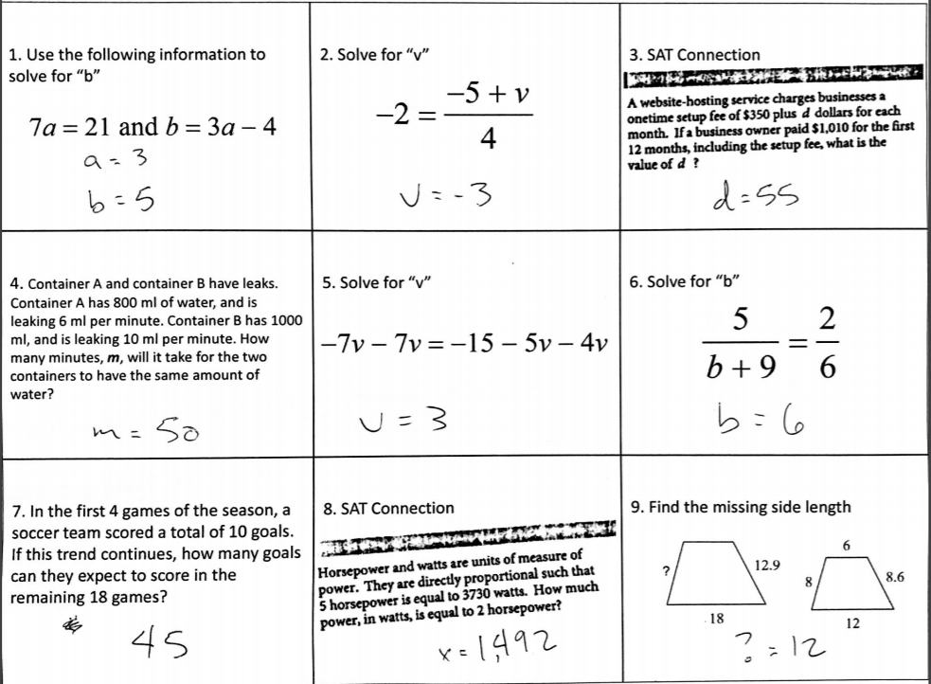
1. Use the following information to solve for “b” | 2. Solve for “v” | 3. SAT Connection
4. Container A and container B have leaks. Container A has 800 ml of water, and is leaking 6 ml per minute. Container B has 1000 ml, and is leaking 10 ml per minute. How many minutes, m, will it take for the two containers to have the same amount of water? | 5. Solve for “v” | 6. Solve for “b”
7. In the first 4 games of the season, a soccer team scored a total of 10 goals. If this trend continues, how many goals can they expect to score in the remaining 18 games? | 8. SAT Connection | 9. Find the missing side length
Skill 1: 1 step equations
Skill 2: 2 step equations
Skill 2: 2 step equations
Skill 3: Variable on both sides
Skill 3: Variable on both sides
Skill 4: Proportions
Skill 4: Proportions
Skill 4: Proportions
Skill 5: Similarity
Skill 5: Similarity
Skill 4: Proportions

Slide 26
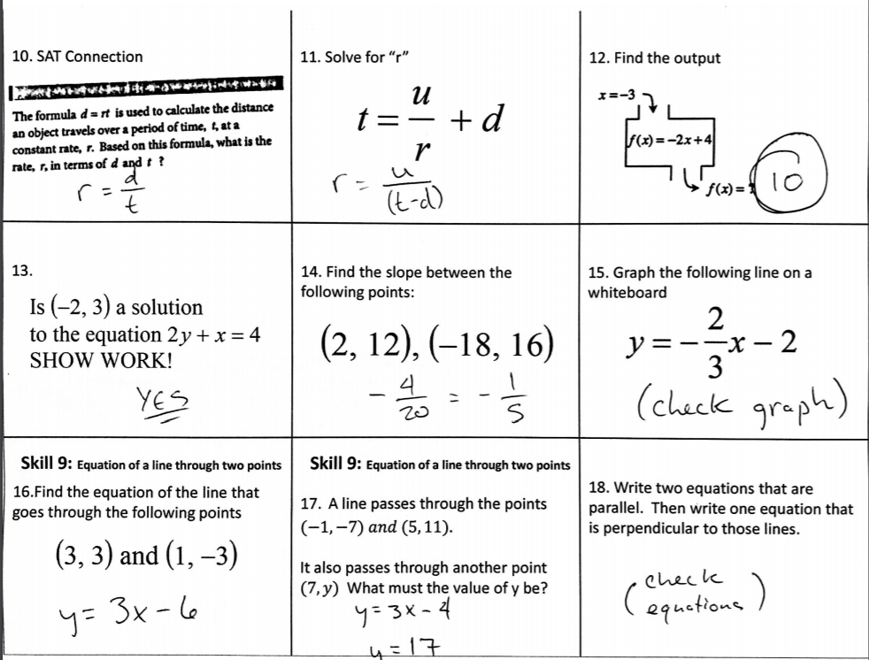
10. SAT Connection | 11. Solve for “r” | 12. Find the output
13. | 14. Find the slope between the following points: | 15. Graph the following line on a whiteboard
16.Find the equation of the line that goes through the following points | 17. A line passes through the points $(−1, −7) and (5, 11).$ It also passes through another point $(7, y)$What must the value of y be? | 18. Write two equations that are parallel. Then write one equation that is perpendicular to those lines.
Skill 6: Formulas
Skill 6: Formulas
Skill 7: Graphing Functions
Skill 7: Graphing Functions
Skill 8: Slope and Y-intercept
Skill 8: Slope and Y-intercept
Skill 9: Equation of a line through two points
Skill 9: Equation of a line through two points
Skill 10: Parallel and Perpendicular
Skill 9: Equation of a line through two points
Skill 9: Equation of a line through two points
Skill 9: Equation of a line through two points
Skill 9: Equation of a line through two points

Slide 27
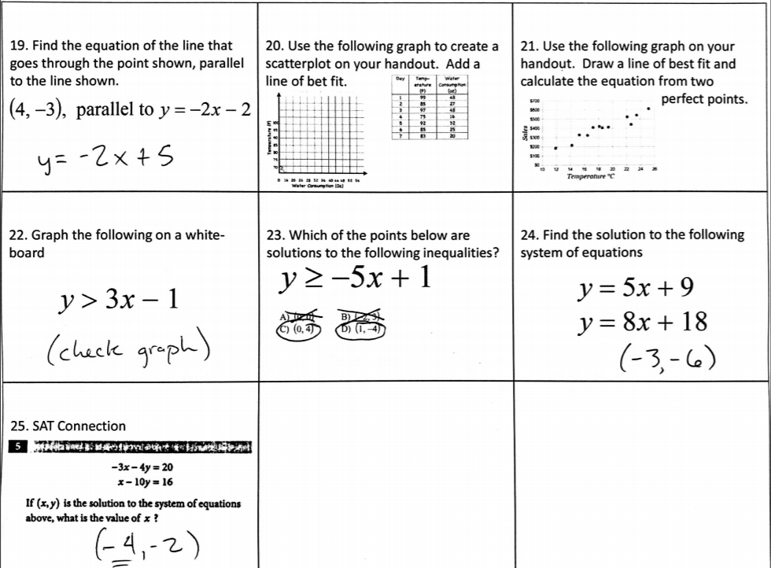
19. Find the equation of the line that goes through the point shown, parallel to the line shown. | 20. Use the following graph to create a scatterplot on your handout. Add a line of bet fit. | 21. Use the following graph on your handout. Draw a line of best fit and calculate the equation from two __________________ perfect points.
22. Graph the following on a white-board | 23. Which of the points below are solutions to the following inequalities? | 24. Find the solution to the following system of equations
25. SAT Connection
Skill 10: Parallel and Perpendicular
Skill 11: Scatterplots
Skill 11: Scatterplots
Skill 12: Inequalities
Skill 12: Inequalities
Skill 13: Systems of Equations
Skill 13: Systems of Equations

Slide 28
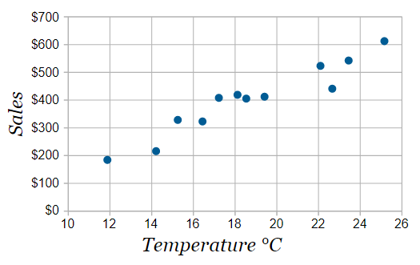
Skill 11 Handout

Slide 29

Skill 11 Handout

